Slide 1
TAXI SERVICE BUSINESS PARTNERSHIP PROPOSAL
PAACAB
Presented by Masud Rana
Email
Website
Phone number
support@paacab.com
https://paacab.com
+447500725687

Slide 2
Table of Contents
Topics to be Discussed
Problem
Solution
Market Scenario
Services
SWOT Analysis
Founder
Presented by Masud Rana

Slide 3
Problem
Local Market
Global taxi apps have still not penetrated the rural remote markets.
Too Expensive
The apps become too expensive for long term usage and commute
Short Duration
Only for short duration usage not fixed travel or monthly basis
Paacab

Slide 4
Solution
-----------------------------------------------------------------------------------------------------------------------------------------------------------------------------------------------------------------------------------------------------------------------------------------------------------------------------------------------------------------------------------------------------------------------------------------------------------------------------------------------------------------------------------------------------------------------------------------------
Local With Vocal
One Cost, Low Cost
Hire the Best
Business with local market penetration and understanding of the rural markets.
Low cost carrier has the potential to create a monopoly in the saturated market
The business with technological and market understanding will always be winning and be providing the best value proposition to customers

Slide 5
Market Scenario
market Size
Market Growth
Competition
The online cab aggregator market is estimated to be of INR 29.75 Billion and in UK it was £6.4 billion in 2020-21
The industry has a high CAGR of 7.7% to 10% globally depending upon the geographic location
The competition in the business targeting the remote rural under penetrated market is very less
Paacab

Slide 6
Services
World Class Experience
Professional Driver Experience
Best Pricing of INR 3 per KM
All in all, best value proposition package
Paacab

Slide 7
SWOT Analysis
Strength
Weakness
Technical Expertise
Focus Market and Audience
Scattered Realised Market
Customer Centric Privacy Policy
Audience Oriented Social Features
Access to Investment Capital
Opportunity
Threat
Supporting Government Policy
Trend in Audience for Domestic Services
Downfall of the market leader
Covid Crisis and Digital Boom
Emerging Competitors
Paacab

Slide 8
Financials
Capital Requirement
$50M
World Class Experience
Professional Driver Experience
Best Pricing of INR 3 per KM
All in all, best value proposition package
Paacab

Slide 9
Financials
Car Hire Purchase
20%
Marketing
20%
Usage of Funds
Product Development
10%
Operating Expenses
10%
Hiring Drivers
40%
Paacab

Slide 10
Actual business Profitability
Paacab

Slide 11
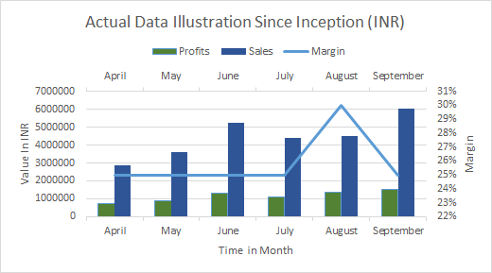
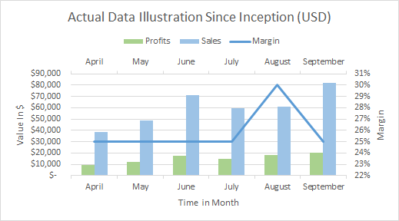
Graphical View
Paacab

Slide 12
Projection in USD
FY Forecasts
Present Quarter Data (Q1 and Q2)
Forecasted Data
(Q3, Q4)
Paacab

Slide 13
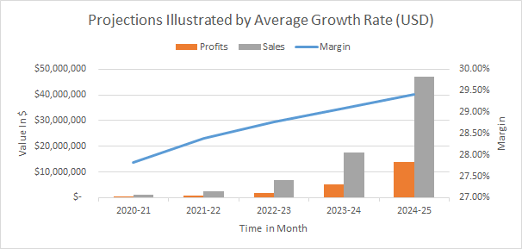
Projection in USD
Paacab

Slide 14
Pictures
Paacab

Slide 15
Pictures
Paacab

Slide 16
Founder
Masud Rana
.....................................................................
.....................................................................
.....................................................................
.....................................................................
.....................................................................
.....................................................................
Paacab

Slide 17
EMAIL ADDRESS
hello@reallygreatsite.com
PAACAB
PHONE NUMBER
Presented by Masud Rana
(123) 456 7890
Let's Talk
WEBSITE
We're open for questions and comments.
https://paacab.com/
Paacab

